Slide 1

Designing of IoT Solutions
IoT Physical Devices & Endpoints
Charanraj B R
Department of Computer Science Engineering

Slide 2

Designing of Iot solutions
IoT Devices
Charanraj B R
Department of Computer Science Engineering

Slide 3
Designing of IoT Solution
Outline of Presentation
IoT Deices

Slide 4
Designing of IoT Solution
What is an IoT Device
A "Thing" in Internet of Things (IoT) can be any object that has a unique identiﬁer and which can send/receive data (including user data) over a network (e.g., smart phone, smart TV, computer, refrigerator, car, etc. ).
IoT devices are connected to the Internet and send information about themselves or about their surroundings (e.g. information sensed by the connected sensors) over a network (to other devices or servers/storage) or allow actuation upon the physical entities/environment around them remotely.

Slide 5
Designing of IoT Solution
IoT Device Examples
A home automation device that allows remotely monitoring the status of appliances and controlling the appliances.
An industrial machine which sends information abouts its operation and health monitoring data to a server.
A car which sends information about its location to a cloud-based service.
A wireless-enabled wearable device that measures data about a person such as the number of steps walked and sends the data to a cloud-based service.

Slide 6
Designing of IoT Solution
Advantages of IoT Devices
Advantages
M2M.
Automation and control.
Technical information.
Monitoring feature.
Time and Money
Monitoring of devices.
Efficiency .
Better quality of life.

Slide 7
Designing of IoT Solution
Dis-advantages of IoT Devices
Dis-Advantages
International compatibility standard.
Highly complex resulting in failure.
Affected by privacy and security breach.
Reduced safety.
Job reductions.
Control of life in due course of time with increasing AI technology.

Slide 8
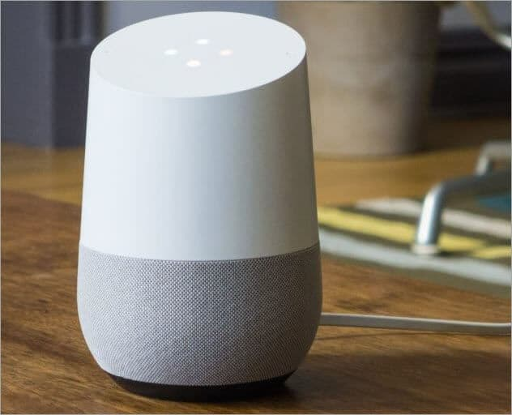

Designing of IoT Solution
Top 10 IoT Devices Examples
1) Google Home Voice Controller
2) Amazon Echo Plus Voice Controller

Slide 9

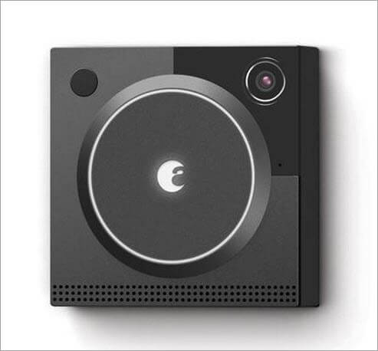
Designing of IoT Solution
Top 10 IoT Devices Examples
3) Amazon Dash Button
4) August Doorbell Cam

Slide 10
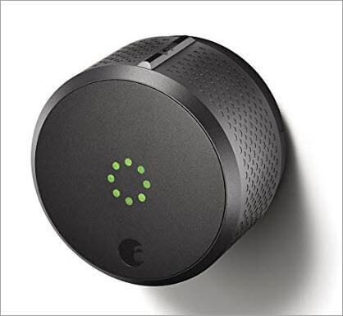
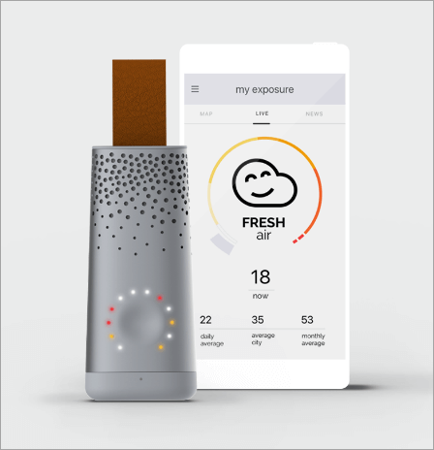
Designing of IoT Solution
Top 10 IoT Devices Examples
5) August Smart Lock
6) Flow by Plume Labs Air Pollution Monitor

Slide 11
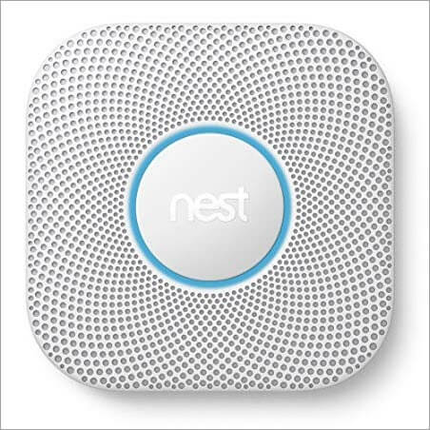
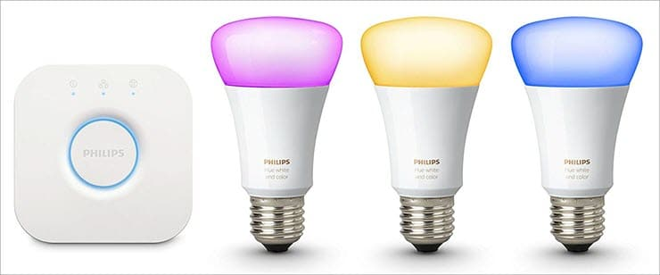
Designing of IoT Solution
Top 10 IoT Devices Examples
7) Nest Smoke Alarm
8) Philips Bulbs and Lighting System

Slide 12
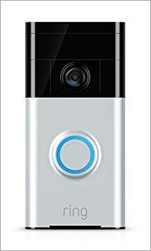
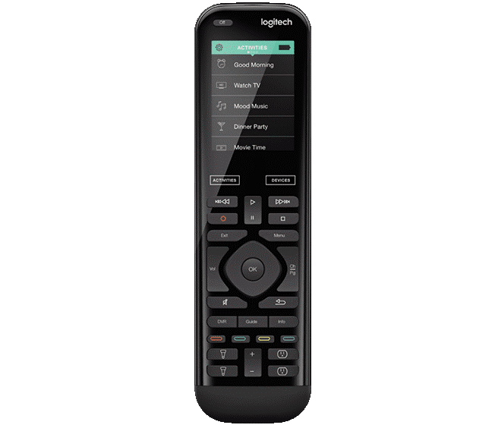
Designing of IoT Solution
Top 10 IoT Devices Examples
9) Ring Doorbell
10) Logitech Universal Remote

Slide 13
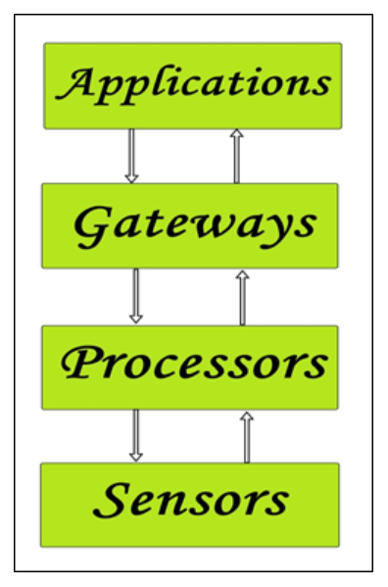
Designing of IoT Solution
Simpliefied building blocks of an IoT Device

Slide 14
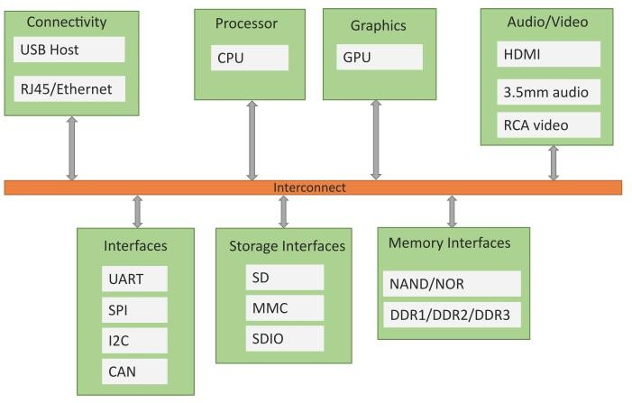
Designing of IoT Solution
Block diagram of an IoT Device

Slide 15
Designing of IoT Solution
Exemplary Device: Raspberry Pi
Raspberry Pi is a low-cost mini-computer
Raspberry Pi runs various favours
Through the general purpose I/O pins.
It supports Python

Slide 16
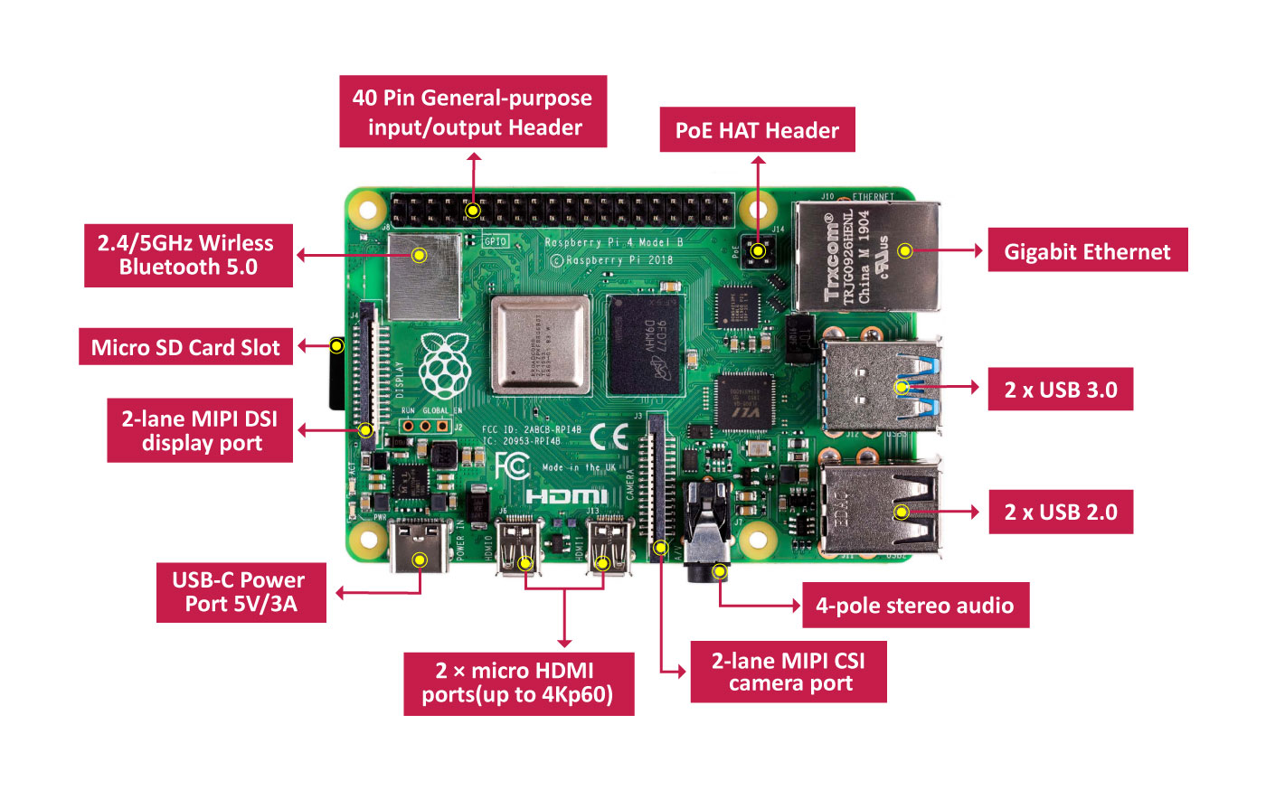
Designing of IoT Solution
Raspberry Pi

Slide 17
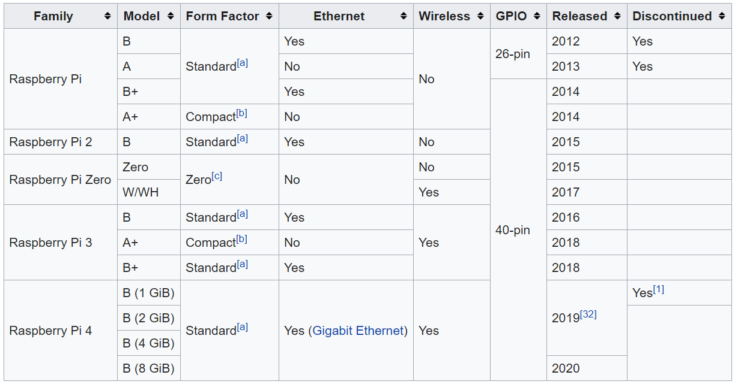
Designing of IoT Solution
Raspberry Pi Versions

Slide 18
Designing of IoT Solution
Raspberry Pi- Raspbian OS
Raspbian is a 32 bit.
Raspbian Buster and Raspbian Stretch.
Raspbian is a free OS
It comes with over 35,000 packages
Unofficial port of Debian Wheezy armhf with compilation settings adjusted to produce optimized "hard float"
Floating point arithmetic operations.
Raspbian uses PIXEL, Pi Improved X-Window Environment, Lightweight
ARM instruction

Slide 19
Designing of IoT Solution
Linux on Raspberry Pi
Raspbian
Arch
Pidora
RaspBMC
OpenELEC
RISC OS

Slide 20
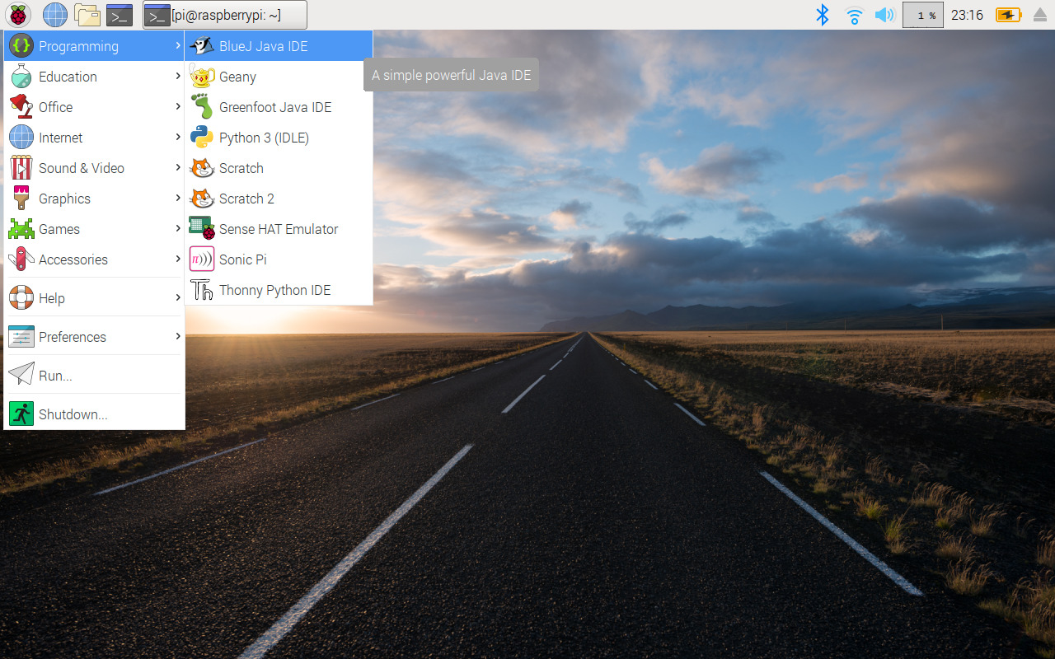
Designing of IoT Solution
Raspberry Pi- Raspbian OS

Slide 21
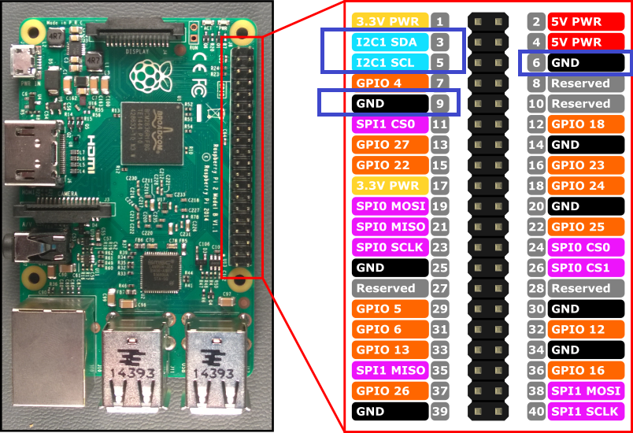
Designing of IoT Solution
Raspberry Pi GPIO

Slide 22
Designing of IoT Solution
Raspberry Pi Interfaces
Serial
Raspberry Pi has (Rx) and (Tx) pins
SPI
Used for communicating with one or more peripheral devices.
MISO (Master in slave out) ,MOSI (Master out slave in) , SCK (Serial Clock) ,CE0 (Chip Enable 0) , CE0 (Chip Enable 1)
I2C
Allow you to connect hardware modules.
SDA (data line)
SCL (clock line)

Slide 23
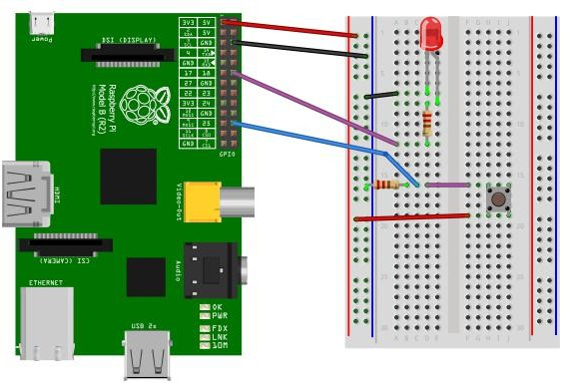
Designing of IoT Solution
Raspberry Pi Example : Interfacing LED and switch with Raspberry Pi
from time import sleep import RPi.GPIO as GPIO GPIO.setmode(GPIO.BCM)
#Switch Pin GPIO.setup(25, GPIO.IN) #LED Pin
GPIO.setup(18, GPIO.OUT)
state=false
def toggleLED(pin):
state = not state GPIO.output(pin, state)
while True:
try:
if (GPIO.input(25) == True): toggleLED(pin)
sleep(.01)
except KeyboardInterrupt: exit()

Slide 24
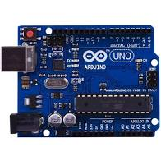
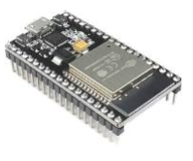
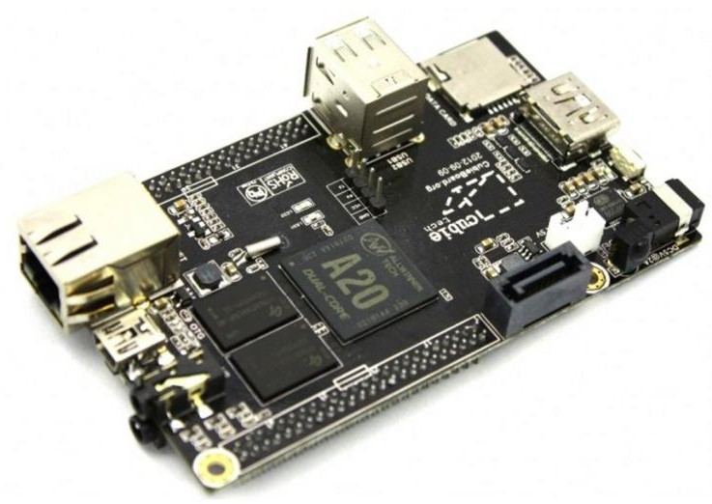
Designing of IoT Solution
Other Devices
Arduino
ESP32
Cubieboard

Slide 25
THANK YOU
Charanraj B R
Department of Computer Science Engineering
charanarajbr@pes.edu
+91 80 6666 3333 Extn 721

